Slide 1

DATA SCIENCE BOOTCAMP Module 2
Tree Based Methods
8th and 9th March 2018
Anindya Moitra
Gaurav Kamboj

Slide 2
Agenda
Segmentation Overview
Tree Concepts
CHAID
Classification and Regression Trees
Ensembling
Bagging Concept
Random Forest
Boosting Concept
Boosting Models

Slide 3

Segmentation

Slide 4
How and Why
In some cases, using several models for a portfolio provides better differentiation/outcome than using a single model on the entire portfolio. This is the case where a population is made up of distinct subpopulations. The process of identifying the subpopulations is called segmentation. For example, while building an acquisition model, entire population can be segmented by market – like Emerging, Mid-Large and Strategic.
The three primary challenges to a successful segmentation:
Selecting the optimal variables for use in dividing a population into subgroups,
Identifying the best statistical algorithms for the segmentation, and
Presenting the results in a usable fashion.
Segmentation can be done in two ways---
Experience Based or Judgmental Segmentation
Statistical Segmentation – Objective & Subjective Segmentation

Slide 5
Judgmental Segmentation
Category | Description
Demographics | Region (Province/State, internal definition, urban/rural, post code, neighborhood), age, lifestyle etc.
Product Type | DB/DC/H&W/401(K)/PS/MPP, Gold/Platinum cards, Length of mortgage, insurance type, secured/unsecured
Channel | Store-front, branch, internet, dealer, broker
Market/Size/Industry | Segment by Asset class – Emerging, Mid-Large, Strategic; Large vs small companies in terms of employee size ; Segment by industry
Data Availability | Robust vs Partial Method, Thin vs Thick file, Clean vs Dirty (Dirty denotes negative performance) file, zero vs non zero,
Applicant Type | Existing/New, First time home buyer vs Mortgage Applicant

Slide 6
Approach to Segmentation
Segmentation is of 2 types
Objective Segmentation
Subjective Segmentation
Clear Objective to divide population
Response rate
Increase in Sales
Conversion proportion
First level analysis to see what lies within
Who are my customers?
Who buys what?
When do they buy?
Objective defined Analysis. To identify the desired segment within population. Then devising strategy to tap the potential within.
Initial Analysis to Understand & Define the Population. Based on the initial understanding – Objective Based Analysis.
Tree Based Methods
Cluster Analysis

Slide 7
Objective Segmentation
Objective Segmentation a common technique used in the Analytics Industry, where a Portfolio of Customers is segmented in few groups based on their performance along a parameter. This parameter is called the Relevance Factor or the Dependent Variable. While the variables which are used to segment the population are called the Predictors or Independent Variables.
Key highlights of Objective Segmentation --
Have some Business Objective in mind beforehand
Directly aims at producing actionable segments with respect to outcome attribute
Used to form Business rules
Can be used for Target Marketing
Common Technique used is Decision Tree (CART / CHAID)

Slide 8

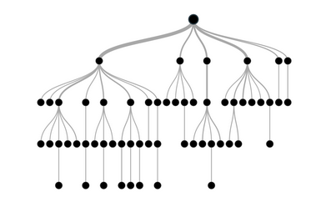
What is a Decision Tree?
Supervised learning algorithm (having a pre-defined target variable)
Works for both categorical and continuous input and output variables
Population or sample is split into two or more homogeneous sets (or sub-populations) based on
most significant splitter / differentiator in input variables

Slide 9
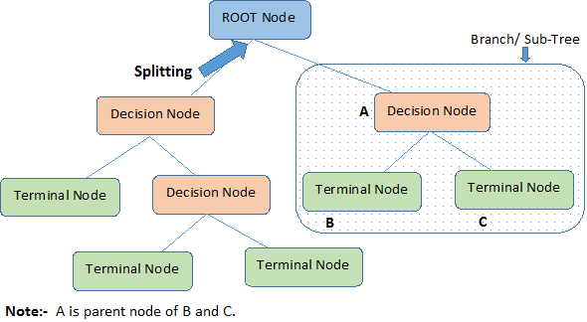
How does it work?
Decision trees classify instances or examples by starting at the root of the tree and moving through it
until a leaf node

Slide 10


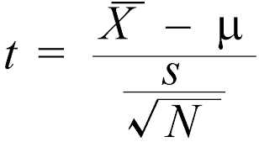
How does a tree decide where to split?
Multiple algorithms to decide to split a node in two or more sub-nodes
1. Gini Index: for a given node t
(Where - p( j | t) is the relative frequency of class j at node t).
2. Chi Square: For a given node
3. Entropy: For a given node t:
(Where - p( j | t) is the relative frequency of class j at node t).
Measures homogeneity of a node.
Maximum (1) when records are equally distributed among all classes implying least information.
Minimum (0) when all records belong to one class, implying most information
4. Reduction in variance :
5. T test:

Slide 11
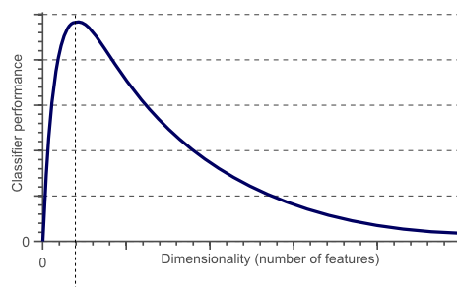
Curse of Dimensionality and Overfitting
Important when designing a classifier : To obtain an even more accurate classification, we could add
more features. But, after a certain point, increasing the dimensionality of the problem by adding new
features would actually degrade the performance of our classifier
How to avoid it?
Feature Selection – Select an optimal subset of M features such that M<N
Feature Extraction - Replace the set of N features by a set of M features
Key Parameters / Pruning -Cross Validation - One subset is used to test the accuracy and precision of the resulting classifier

Slide 12
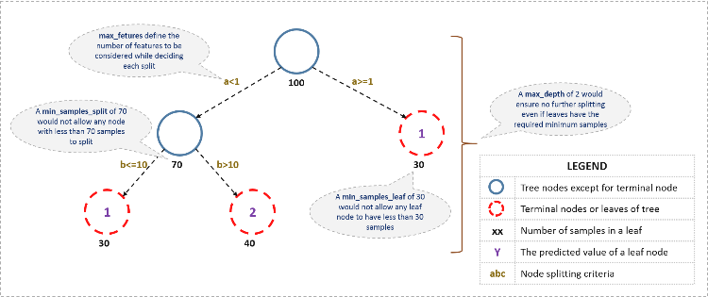
Key Parameters of Tree Modeling
Setting Constraints on Tree Size
Minimum samples for node split
Minimum samples for a terminal node
Maximum depth of tree
Maximum number of terminal nodes
Maximum features to consider for split
2. Tree Pruning : Cost complexity pruning using cross validation error

Slide 13
Advantages & Disadvantages
Pros
Interpretability – Easy to understand
Useful in Data exploration
Less data cleaning required
Non Parametric Method
Cons –
Over fitting
Do no have same predictive accuracy as compared to other approaches
Are tree based models better than linear models?
If the relationship between dependent & independent variable is linear– Linear Model
If there is a high non-linearity & complex relationship – Tree Bases Model
If you need to build a model which is easy to explain/ to build rules – Tree Based Model

Slide 14
Chi-squared Automatic Interaction Detector (CHAID)
The acronym CHAID stands for Chi-squared Automatic Interaction Detector. This name derives from the basic algorithm that is used to construct (non-binary) trees, which for classification problems (when the dependent variable is categorical in nature) relies on the Chi-square test to determine the best next split at each step; for regression-type problems (continuous dependent variable) the program will actually compute F-tests. Specifically, the algorithm proceeds as follows:
Preparing predictors : The first step is to create categorical predictors out of any continuous predictors by dividing the respective continuous distributions into a number of categories with an approximately equal number of observations. For categorical predictors, the categories (classes) are "naturally" defined.
Merging categories : The next step is to cycle through the predictors to determine for each predictor the pair of (predictor) categories that is least significantly different with respect to the dependent variable; for classification problems (where the dependent variable is categorical as well), it will compute a Chi-square test . If the respective test for a given pair of predictor categories is not statistically significant as defined by an alpha-to-merge value, then it will merge the respective predictor categories and repeat this step (i.e., find the next pair of categories, which now may include previously merged categories). If the statistical significance for the respective pair of predictor categories is significant (less than the respective alpha-to-merge value), then (optionally) it will compute a Bonferroni adjusted p-value for the set of categories for the respective predictor.
Selecting the split variable. The next step is to choose the split the predictor variable with the smallest adjusted p-value, i.e., the predictor variable that will yield the most significant split; if the smallest (Bonferroni) adjusted p-value for any predictor is greater than some alpha-to-split value, then no further splits will be performed, and the respective node is a terminal node.

Slide 15
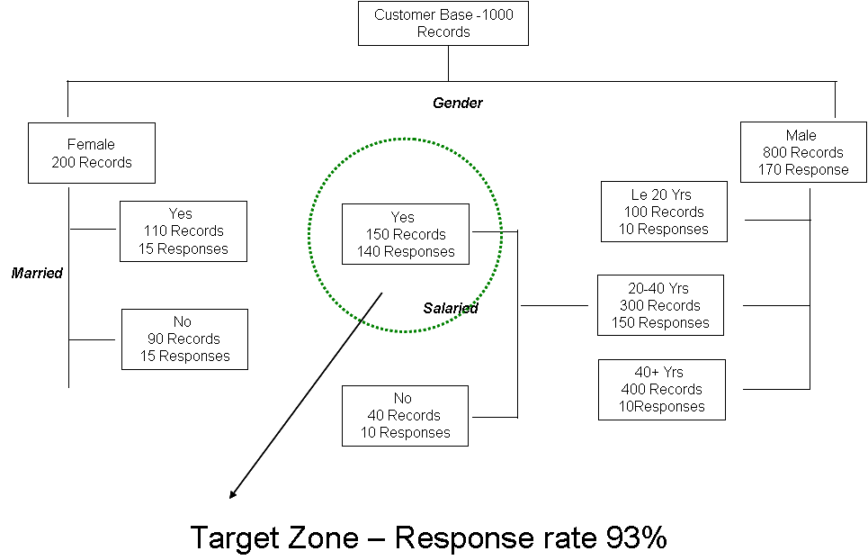
CHAID - Example
Consider a test mailing to a random sample of 1000 individuals.
Two Hundred individuals responded, yielding a 20% response rate.
Objective: We are interested in identifying the characteristics of the responders.

Slide 16
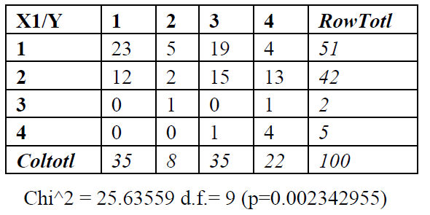
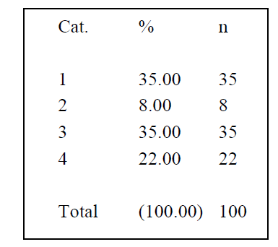
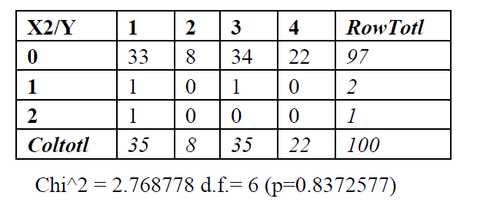
CHAID – How the Algorithm Works.. (1/5)

Slide 17
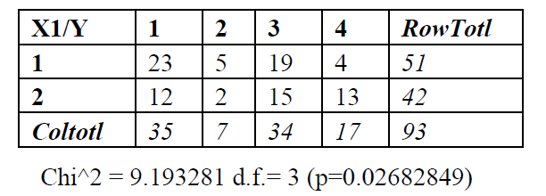
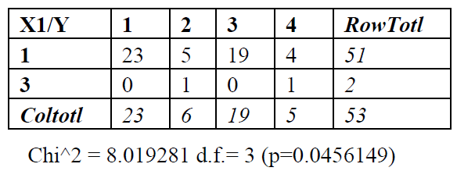
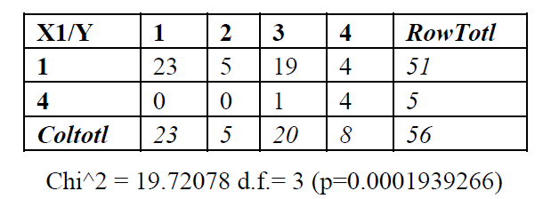
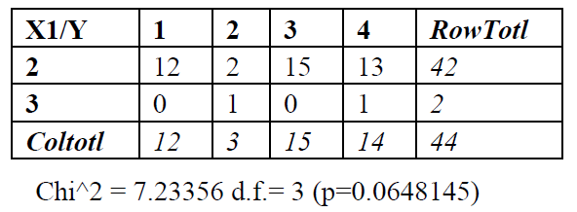
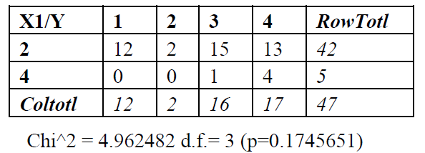
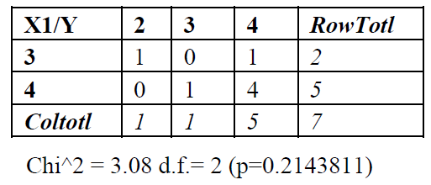
CHAID – How the Algorithm Works.. (2/5)

Slide 18
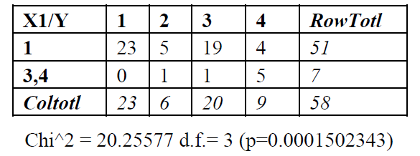
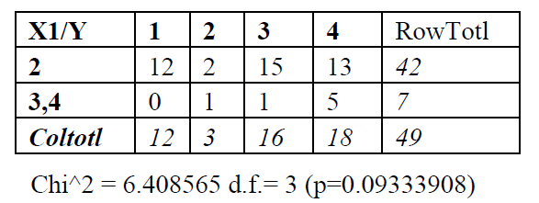
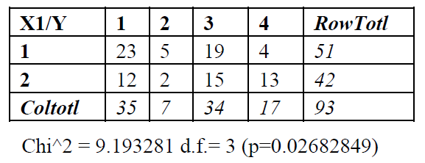
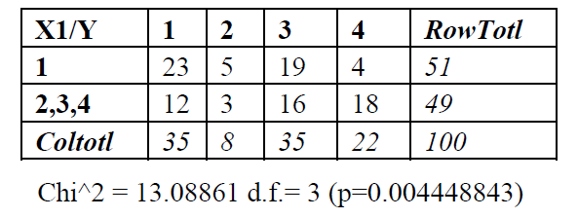
CHAID – How the Algorithm Works.. (3/5)

Slide 19
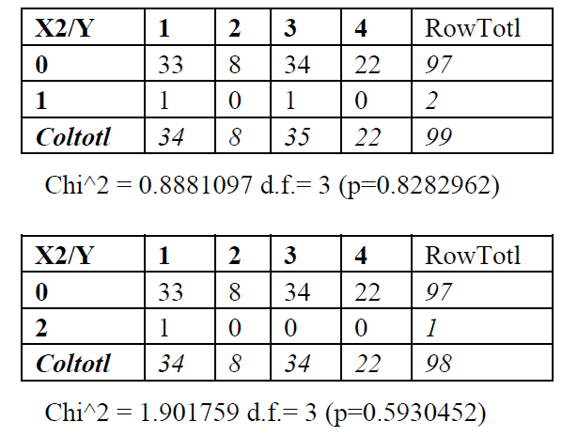
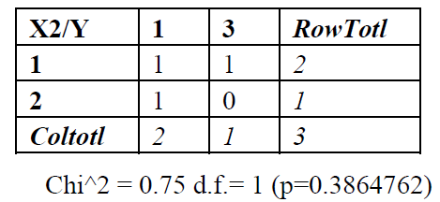
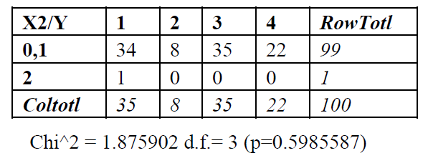
CHAID – How the Algorithm Works.. (4/5)

Slide 20
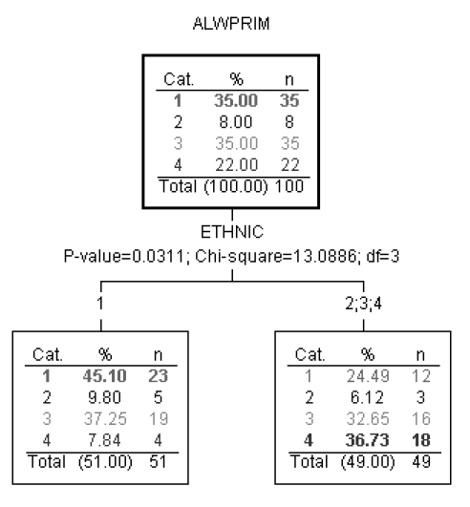
CHAID – How the Algorithm Works.. (5/6)

Slide 21
CART: Classification And Regression Trees
Select the variable value (X=t₁) that produces the greatest “separation” in the target variable.
“Separation” defined in many ways.
Regression Trees (continuous target): use sum of squared errors.
Classification Trees (categorical target): Gini measure
Tree-based modeling for continuous target variable
most intuitively appropriate method for loss ratio analysis
Find split that produces greatest separation in
∑[y – E(y)]²
i.e.: find nodes with minimal within variance
and therefore greatest between variance
like credibility theory
Every record in a node is assigned the same yhat
➔ model is a step function
Regression Tree
Tree-based modeling for discrete target variable
In contrast with regression trees, various measures of purity are used
Common measures of purity:
Gini
Intuition: an ideal retention model would produce nodes that contain either defectors only or non-defectors only
completely pure nodes
Classification Tree

Slide 22
CART: Classification And Regression Trees
Classification Tree
Regression Tree
Splitting Criteria:
Gini
Goodness of fit measure:
misclassification rates
Prior probabilities and misclassification costs
available as model “tuning parameters”
Splitting Criterion:
sum of squared errors
Goodness of fit:
same measure!
sum of squared errors
No priors or misclassification costs…
… just let it run

Slide 23
How CART Selects the Optimal Tree
Use cross-validation (CV) to select the optimal decision tree.
Built into the CART algorithm.
Essential to the method; not an add-on
Basic idea: “grow the tree” out as far as you can…. Then “prune back”.
CV: tells you when to stop pruning.

Slide 24
CART: Growing, Pruning & Finding Right Tree
One approach: stop growing the tree early.
But how do you know when to stop?
CART: just grow the tree all the way out; then prune back.
Sequentially collapse nodes that result in the smallest change in purity.
“weakest link” pruning.
“Inside every big tree is a small, perfect tree waiting to come out.”
--Dan Steinberg
2004 CAS P.M. Seminar
The optimal tradeoff of bias and variance.
But how to find it??

Slide 25
CART: Pruning
Definition: Cost-Complexity Criterion
R_{α}= MC + αL
MC = misclassification rate
Relative to # misclassifications in root node.
L = # leaves (terminal nodes)
You get a credit for lower MC.
But you also get a penalty for more leaves.
Let T₀ be the biggest tree.
Find sub-tree of T_{α} of T₀ that minimizes R_{α}.
Optimal trade-off of accuracy and complexity.
Cost-Complexity Pruning
Let’s sequentially collapse nodes that result in the smallest change in purity.
This gives us a nested sequence of trees that are all sub-trees of T₀.
T₀ » T₁ » T₂ » T₃ » … » T_{k} » …
Theorem: the sub-tree T_{α} of T₀ that minimizes R_{α} is in this sequence!
Gives us a simple strategy for finding best tree.
Find the tree in the above sequence that minimizes CV misclassification rate.
Weakest-Link Pruning

Slide 26
CART: What is the Optimal Size?
Note that α is a free parameter in: R_{α}= MC + αL
1:1 correspondence betw. α and size of tree.
What value of α should we choose?
α=0 ➔ maximum tree T₀ is best.
α=big ➔ You never get past the root node.
Truth lies in the middle.
Use cross-validation to select optimal α (size)
Finding “α”
Fit 10 trees on the “blue” data.
Test them on the “red” data.
Keep track of mis-classification rates for different values of α.
Now go back to the full dataset and choose the α-tree.

Slide 27
CART: What is the Optimal Size?
Grow the tree on all the data: T₀.
Now break the data into 10 equal-size pieces.
10 times: grow a tree on 90% of the data.
Drop the remaining 10% (test data) down the nested trees corresponding to each value of α.
For each α add up errors in all 10 of the test data sets.
Keep track of the α corresponding to lowest test error.
This corresponds to one of the nested trees T_{k}«T₀.
Relative error: proportion of CV-test cases misclassified.
According to CV, the 15-node tree is nearly optimal.
In summary: grow the tree all the way out.
Then weakest-link prune back to the 15 node tree

Slide 28
Commonly used Tree Algorithms: CART , CHAID , CTREE ,C4.5, C5.0,ID3
CART | CHAID
No distributional assumption of data | The predictor and dependent are not be highly correlated.
Dependent variable can be categorical/continuous | Dependent variable can be categorical/continuous
Predictor variable can be categorical/continuous | Predictor variable can only be categorical. In case the predictors are continuous then it should be classified into various categories
It uses a binary split | It uses a multiway split
It uses Gini measure for selecting best split when dependent is categorical. In case of continuous dependent, Least-squared Deviation is used. | It uses Bonferroni adjusted p- values obtained from Chi square test for selecting best split.
Handles missing data by keeping track of surrogate or treating it as separate category | It classifies the missing values as a single category
Tree size is very large. The splitting can be stopped when a node is either pure or contains minimum number of cases. | Tree sizes are relatively smaller than in CART as it employs multiway splits
It generally over fits the data. Pruning is generally done to avoid it. | It avoids over fitting because the next split is done only if it is statistically significant

Slide 29



Ensembling
In general, ensembling is a technique of combining two or more algorithms of similar or dissimilar types called base learners. This is done to make a more robust system which incorporates the predictions from all the base learners. It can be understood as conference room meeting between multiple traders to make a decision on whether the price of a stock will go up or not
Since all of them have a different understanding of the stock market and thus a different mapping function from the problem statement to the desired outcome. Therefore, they are supposed to make varied predictions on the stock price based on their own understandings of the market.
Now we can take all of these predictions into account while making the final decision. This will make our final decision more robust, accurate and less likely to be biased. The final decision would have been opposite if one of these traders would have made this decision alone.
You can consider another example of a candidate going through multiple rounds of job interviews. The final decision of candidate’s ability is generally taken based on the feedback of all the interviewers. Although a single interviewer might not be able to test the candidate for each required skill and trait. But the combined feedback of multiple interviewers usually helps in better assessment of the candidate.
Averaging: It’s defined as taking the average of predictions from models in case of regression problem or while predicting probabilities for the classification problem
Weighted average: In this, different weights are applied to predictions from multiple models then taking the average which means giving high or low importance to specific model output.
Majority vote: It’s defined as taking the prediction with maximum vote / recommendation from multiple models predictions while predicting the outcomes of a classification problem.

Slide 30
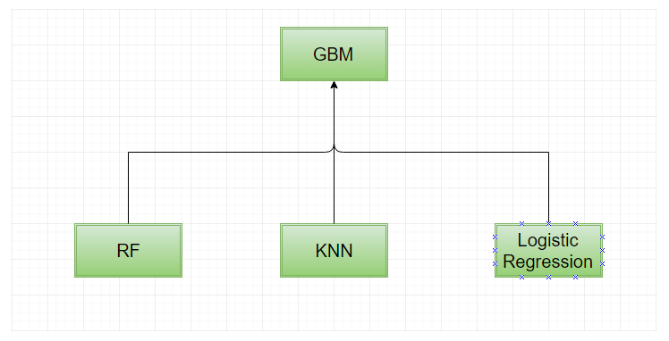
Ensembling – Example
Step 1: Train the individual base layer models on training data
Step 2: Predict using each base layer model for training data and test data
Step 3: Now train the top layer model again on the predictions of the bottom layer models that has been made on the training data
Step 4: Finally, predict using the top layer model with the predictions of bottom layer models that has been made for testing data
Great! You made your first ensemble.

Slide 31
Advantages and Disadvantages of Ensembling
Advantage
Ensembling is a proven method for improving the accuracy of the model and works in most of the cases.
It is the key ingredient for winning almost all of the machine learning hackathons.
Ensembling makes the model more robust and stable thus ensuring decent performance on the test cases in most scenarios.
You can use ensembling to capture linear and simple as well non-linear complex relationships in the data. This can be done by using two different models and forming an ensemble of two.
Disadvantages
Ensembling reduces the model interpretability and makes it very difficult to draw any crucial business insights at the end.
It is time-consuming and thus might not be the best idea for real-time applications.
The selection of models for creating an ensemble is an art which is really hard to master.

Slide 32
Bagging (1/3)
Bagging is a powerful method to improve the performance of simple models and reduce overfitting of more complex models. The principle is very easy to understand, instead of fitting the model on one sample of the population, several models are fitted on different samples (with replacement) of the population. Then, these models are aggregated by using their average, weighted average or a voting system (mainly for classification)
Though bagging reduces the explanatory ability of your model, it makes it much more robust and able to get the ‘big picture’ from your data
Bagged trees (But not exactly a random forest)
To build a bagged trees, the process is easy. Let’s say you want 100 models that you will average, for each of the hundred iterations you will:
Take a sample with replacement of your original dataset
Train a regression/classification tree on this sample
Save the model with your other models
Once you trained all your models, to get a prediction from your bagged model on new data, you will need to:
Get the estimate from each of the individual trees you saved.
Average/vote the estimates

Slide 33
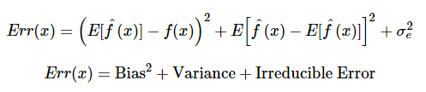
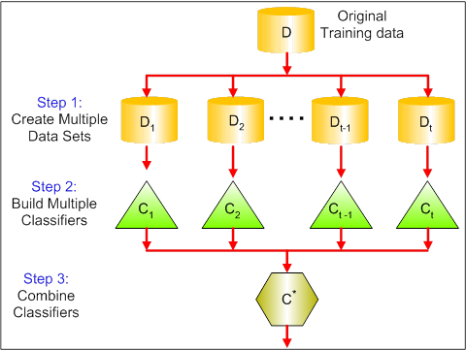
Bagging (2/3)
Components of error in any model
Bagging tries to implement similar learners on small sample populations and then takes a mean of all the predictions. Procedure to reduce the variance.
Bootstrap
(sampling with
replacement)
& = Bagging
Aggregating
Random Forest is one of the implementations of bagging models

Slide 34
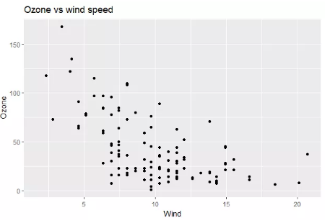
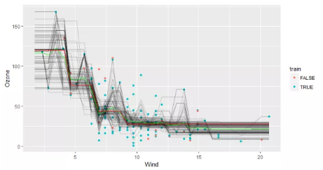
Bagging (3/3)
The relationship is not linear, hence using regression trees may be efficient. The dataset is split between a training set with 80% of the data and a testing set with 20% of the data.
Then, a regression tree was trained on all the training data and 100 trees were trained on a bootstrapped sample of the data.
The red line represents the estimate from the single tree. The green line represents the bagged model and each gray line a model fitted on a single sample. The bagged model seems to be a good compromise between the bias from the single tree and the variance (and overfitting) from the trees trained on a bootstrapped sample.

Slide 35

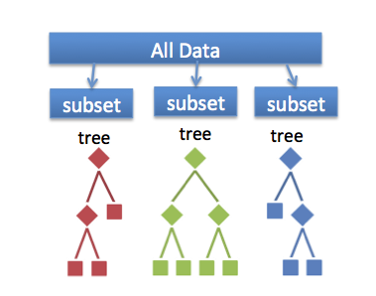
Random Forest Overview(1/2)
Random forests (RF) are an ensemble classifier made using many decision tree models.
Ensemble models combine results from different models.
The forests consists of using randomly selected inputs or combinations inputs at each node to grow each tree.

Slide 36
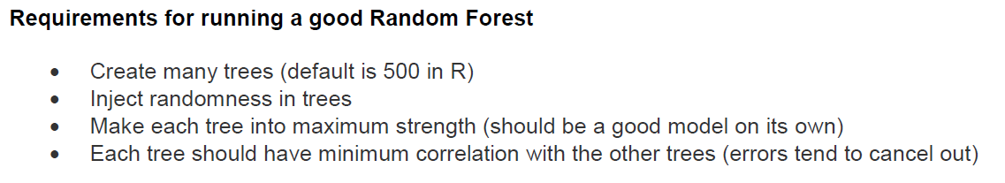
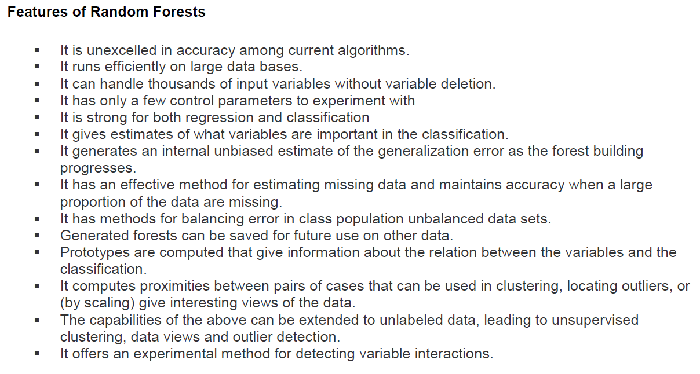
Random Forest Overview (2/2)

Slide 37
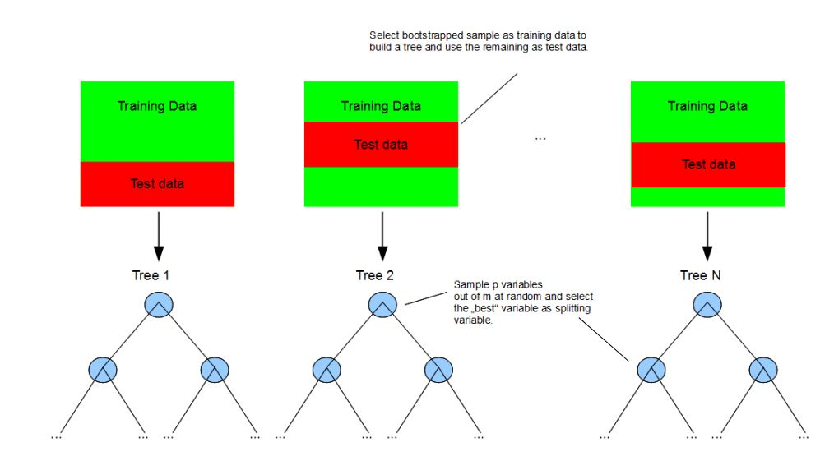
How does Random Forest work (1/2)
Each tree is grown as follows: 1. Random Record Selection : Each tree is trained on roughly 2/3rd of the total training data. Cases are drawn at random with replacement from the original data. This sample will be the training set for growing the tree.
2. Random Variable Selection : Some predictor variables (say, m) are selected at random out of all the predictor variables and the best split on these m is used to split the node. The value of m is held constant during the forest growing.
3. For each tree, using the leftover (1/3rd) data, calculate the misclassification rate - out of bag (OOB) error rate. Aggregate error from all trees to determine overall OOB error rate for the classification.

Slide 38
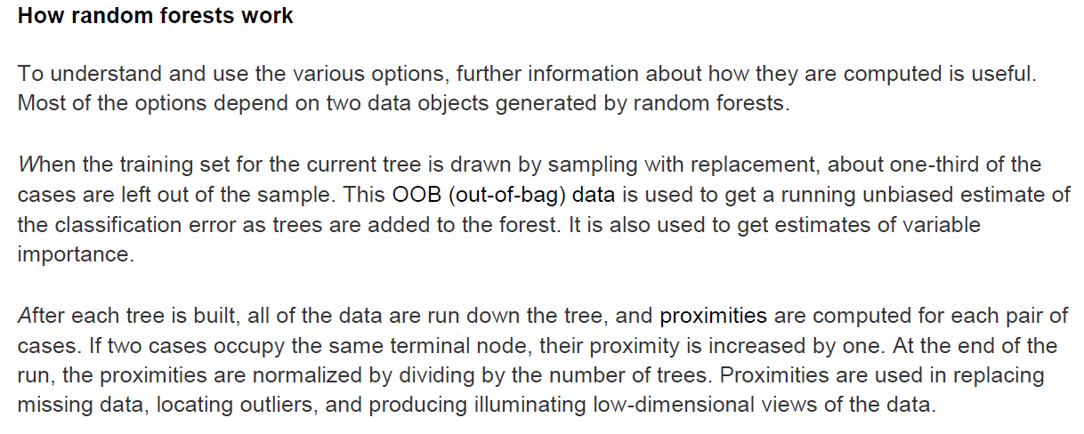
How does Random Forest work (2/2)

Slide 39
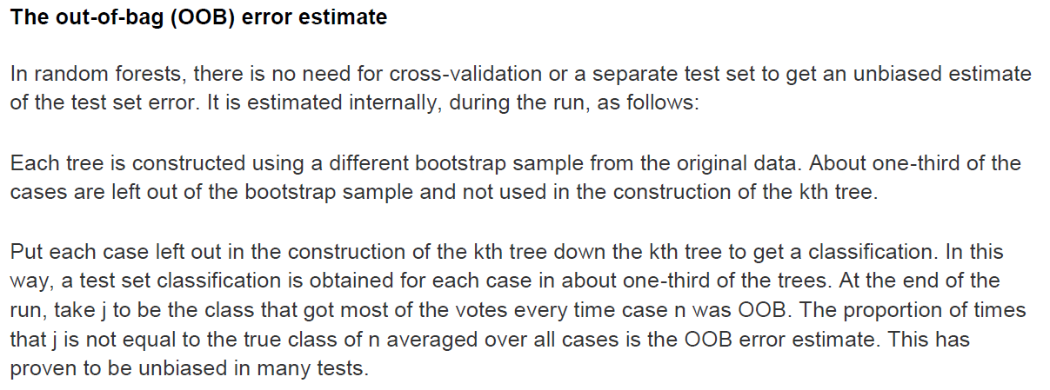
The OOB Error Estimate

Slide 40
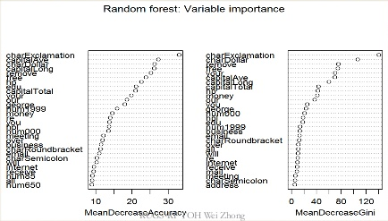
Variable Importance (1/2)
Several measures are available for feature importance in Random Forests:
Gini Importance or Mean Decrease in Impurity (MDI) calculates each feature importance as the sum over the number of splits (across all tress) that include the feature, proportionally to the number of samples it splits.
Permutation Importance or Mean Decrease in Accuracy (MDA) is assessed for each feature by removing the association between that feature and the target. This is achieved by randomly permuting the values of the feature and measuring the resulting increase in error.

Slide 41
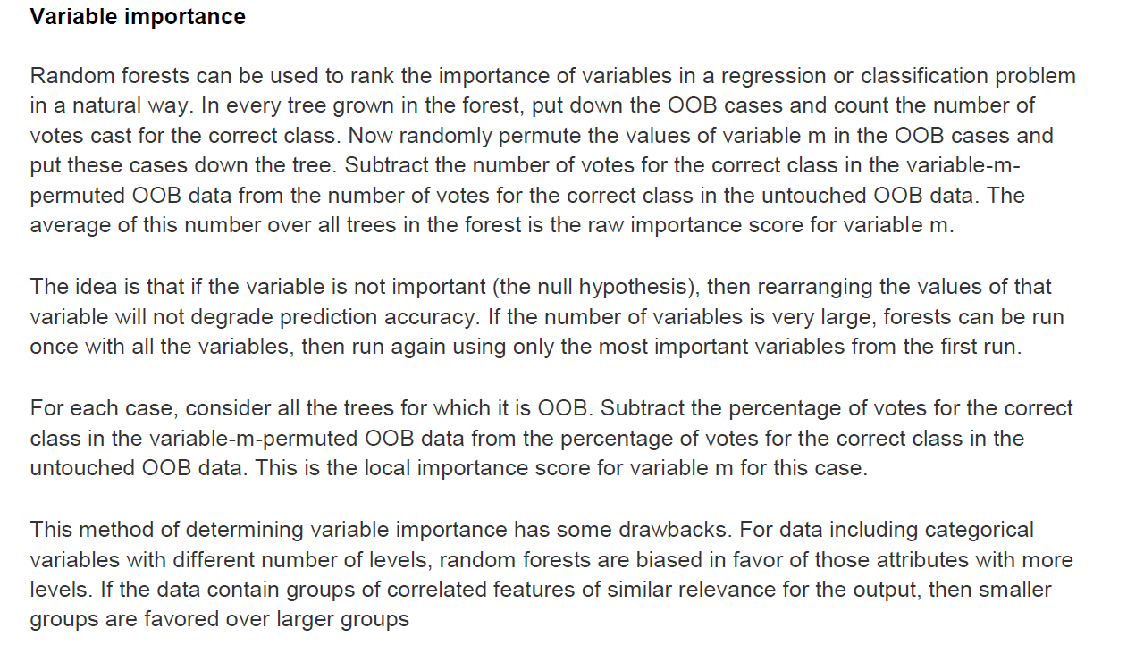
Variable Importance (2/2)

Slide 42
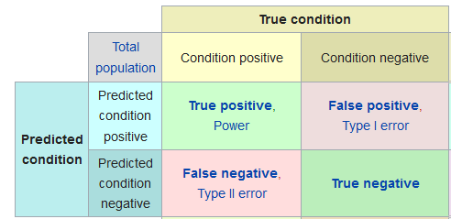

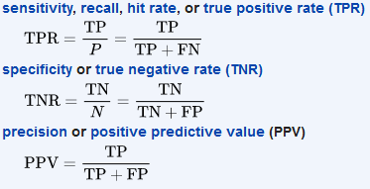

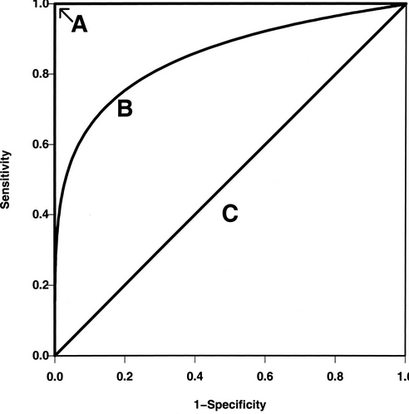
Model Performance of Random Forest
1. Confusion Matrix
2. ROC curve: The ROC curve is a graphical representation of the trade-off between the false negative and false positive rates for every possible cut off

Slide 43
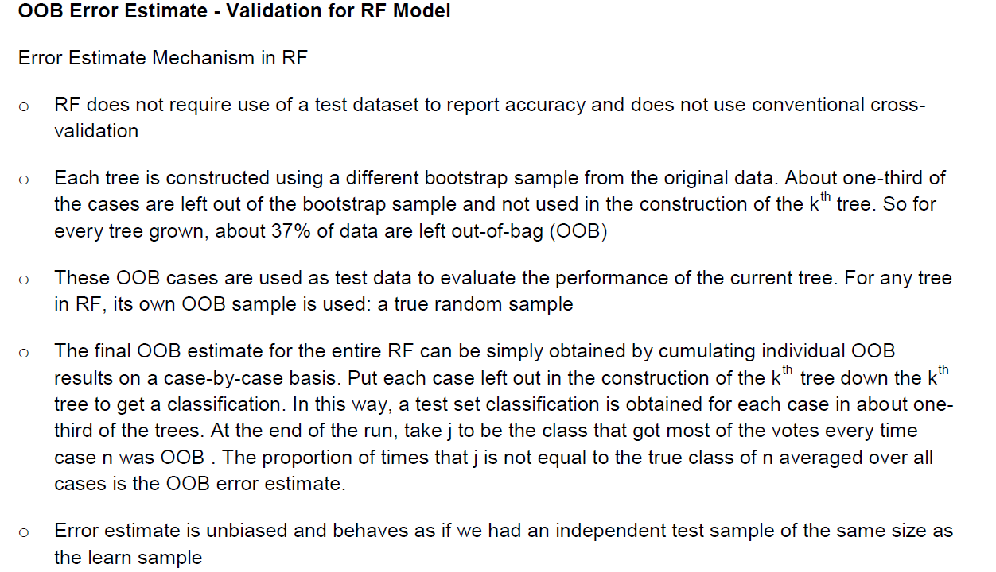
Validation of RF Model

Slide 44
Random Forest Advantages
It is one of the most accurate learning algorithms available
No distribution assumptions i.e. no transformation required
Random Forest does not tend to over fit, cross validation incorporated (but the observations must be independent!)
It can handle thousands of input variables without variable deletion
With increasing number of variables the bias usually decreases
Can be used for variable selection -> variable importance
Robust against outliers in the predictive variables

Slide 45
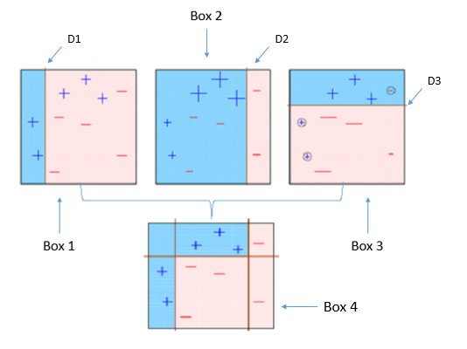
Boosting- How does it work?
Boosting’ refers to a family of algorithms which converts weak learner to strong learners
After many iterations, the boosting algorithm combines these weak rules into a single strong prediction rule. This is an iterative process.
Boosting pays higher focus on examples which are miss-classiﬁed or have higher errors by preceding weak rules
Boosting Algorithms
AdaBoost (Adaptive Boosting)
Gradient Tree Boosting
XGBoost

Slide 46
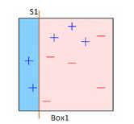
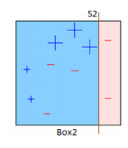
AdaBoost (1/2)
First original boosting technique: highly accurate prediction rule by combining many weak and inaccurate rules.
Classic use case: Face Detection
Box1 : Equal weights are assigned to all observations and a decision stump is applied to classify + or - . S1 has generated a vertical line on the left side to classify the data points. This decision stump incorrectly predicted three +. So, we’ll assign more weight to these three data points in our next decision stump.
Box2 : The size difference between those three incorrectly predicted and the rest of the data points is clearly visible. Another decision stump (S2) is applied to predict them correctly on the right side of the box. But, this time three - are classified incorrectly. Repeat.

Slide 47
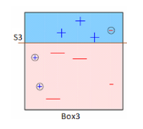
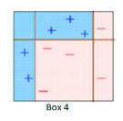
AdaBoost (2/2)
Box3 : Here, three - are given higher weights. S3 is applied to predict these misclassified observations correctly. This time, a horizontal line is generated to classify - and +.
Box4 : Here, we combine S1, S2, and S3 to form a strong prediction having a complex rule as compared to the individual weak learners. Evidently, this algorithm has classified these observations accurately as compared to any of the individual weak learners.

Slide 48
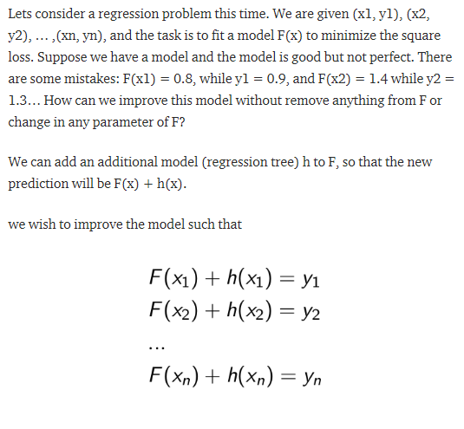
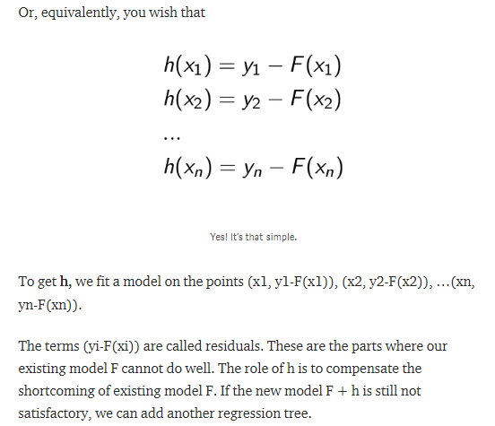
Gradient Tree Boosting (1/2)
ML technique used for regression and classification problems, it produces a prediction model in the form of an ensemble of weak prediction models, typically decision trees
The principle idea behind this algorithm is to construct new base learners which can be maximally correlated with negative gradient of the loss function, associated with the whole ensemble

Slide 49
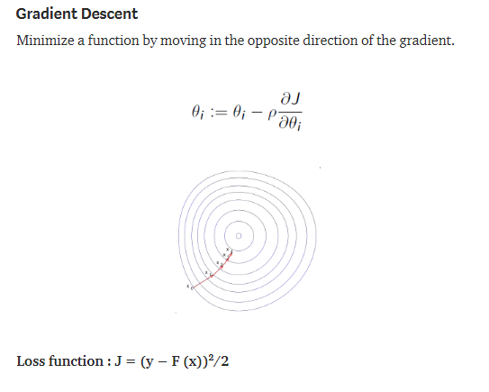
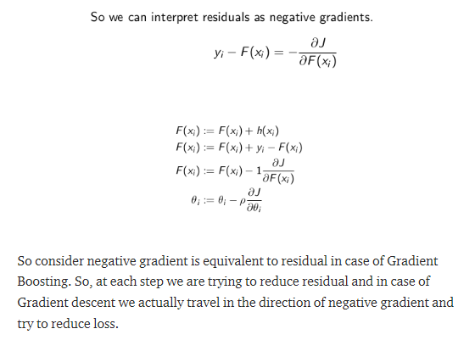
Gradient Tree Boosting (2/2)

Slide 50
XGBoost
Extreme Gradient Boosting (XGBoost) is similar to gradient boosting framework but more efficient. Specifically, XGBoost used a more regularised model formalization to control overfitting, which gives it better performance, which is why it’s also known as ‘regularized boosting‘ technique. It has both linear model solver and tree learning algorithms. Moreover, it has the capacity to do parallel computation on a single machine.
This makes XGBoost at least 10 times faster than existing gradient boosting implementations. It supports various objective functions, including regression, classification and ranking.
Main difference between GBM and XGBoost is in their objective function.
In case of XGBoost Objective Function = Training loss + Regularization

